Slide 1
BabyCare System Project
Surveillance & Locating System Resolution
Wireless Sensor Networks Fan Zhang, Yu Wang, Ying Liu

Slide 2
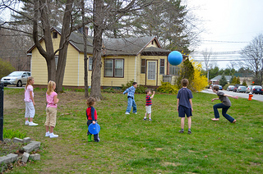
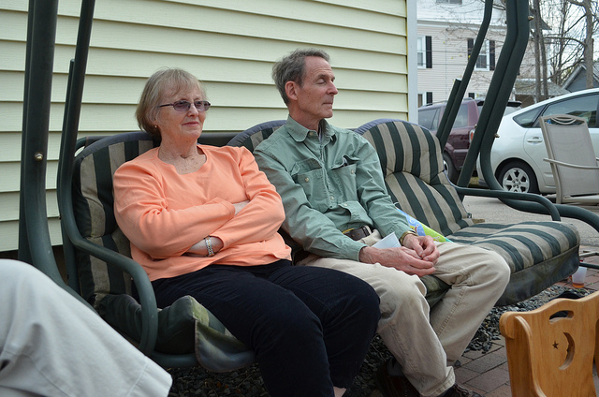
Problems for Parents
Kids want to play in yards
V.S.
Watching consumes too much for parents

Slide 3
Solution for Problem
We are aiming to develop a BabyCare system
using Wireless Sensor Network to keep the kids playing within specific safe region
Main Functions:
Automatically locating the kids periodically
Identify the dangerous movement with suspected movement
Warning the parents by Alarm when kid goes out of range

Slide 4
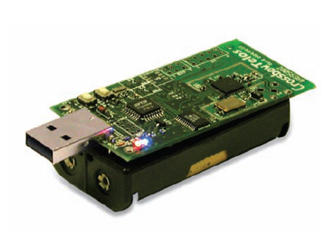
Locating System based on Wireless Sensor Network
Comparative analysis of current locating system, e.g. GPS
Low Cost ( cheaper than GPS model)
High Reliability ( simplified system layer )
Easy Build (unitized, monetized )
Energy Conservation (low-power dissipation )
Tiny OS: OS for wireless sensor networks
nesC: Programming language for TinyOS
Sensor: TelosB
Algorithm: RSSI (Received Signal Strength Indication)

Slide 5
System Architecture
Wireless sensor networks consists of 3 major parts
Emission Section (ES)
mobile device attached to kid broadcasts periodically
Reception Section (RS)
distributed signal receivers that constitute a fixed region
signal strength measurement in 2D space
Base Station (BS)
PC with Linux
Programs calculate distance among ES and RS(s)
Identify Alarm

Slide 6
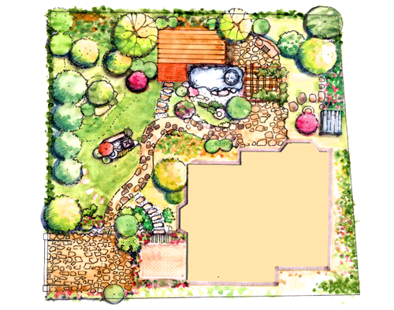
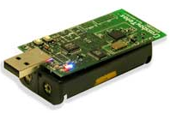
Region
Reception Section
Emission Section

Slide 7
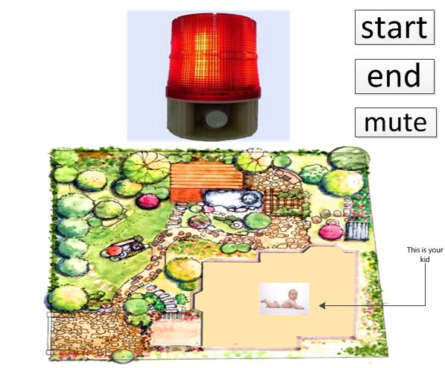
Human Computer Interface
----Go into Detecting Model
------Go into standby Model
-----------------Mute the Alarm

Slide 8
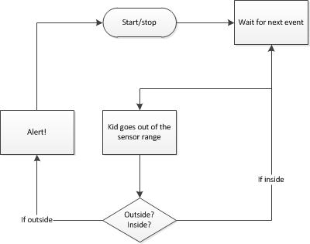
Flow Diagram

